Slide 1

Unit-IV
MGN-101
Controlling
p. b. Narendra Kiran
Assistant professor

Slide 2

At the end of this lecture, you will be able to-
Understand the concept of Controlling
Know the process of controlling
State the Nature and Importance of controlling
Explain Types of controlling and techniques of Controlling

Slide 3
Controlling
Control is a function of management which helps to check errors in order to take corrective actions.
This is done to minimize deviation from standards and ensure that the stated goals of the organization are achieved in a desired manner.

Slide 4
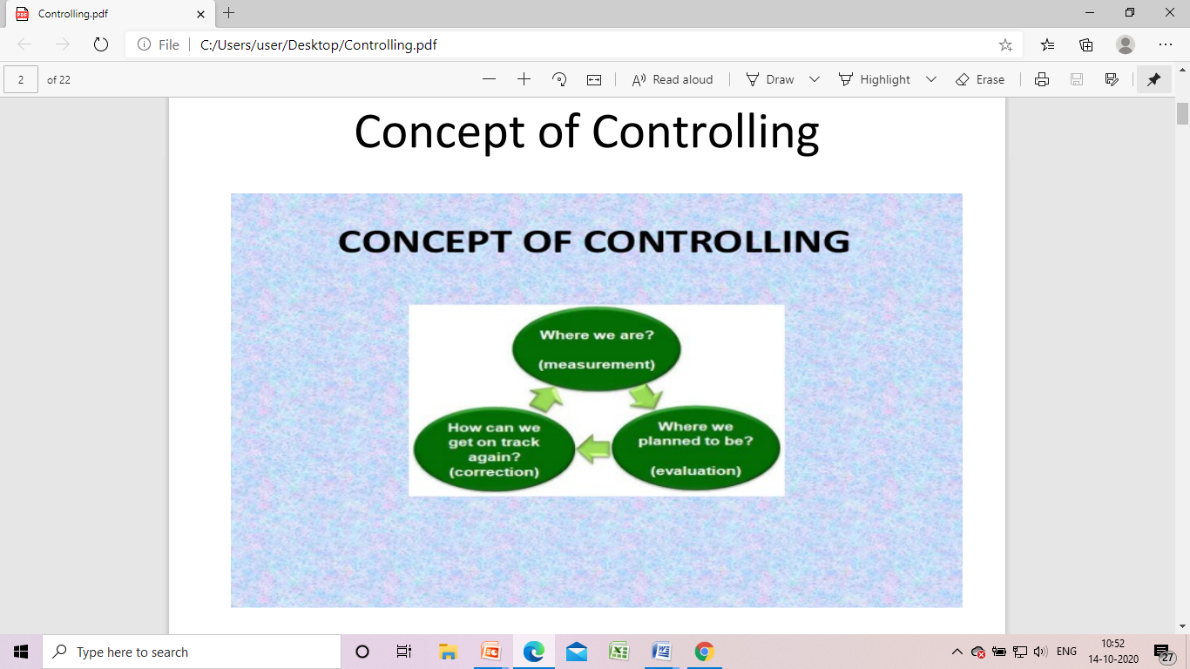

Slide 5
Definitions
“Controlling is the measurement and correction of performance in order to make sure that enterprise objectives and the plans devised to attain them are accomplished.” -Harold Koontz
“Control is checking current performance against pre-determined standards contained in the plans, with a view to ensure adequate progress and satisfactory performance.” -EFL Brech

Slide 6
Planning-control relationship
Planning and controlling are inter-related to each other.
Planning sets the goals for the organization and controlling ensures their accomplishment.
Planning decides the control process and controlling provides sound basis for planning.
In reality planning and controlling are both dependent on each other.
If planning is looking ahead, control is looking back.
In fact, control is the process of checking to determine whether or not proper progress is being made as per the planning.

Slide 7
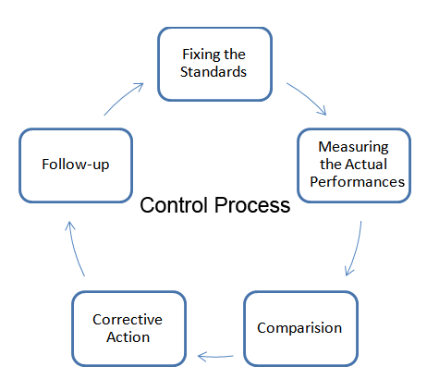
Process of control

Slide 8
Needs of Controlling
Optimum utilization of resources
Minimizes deviation
Increased efficiency
Coping with the changes
Facilitates delegation

Slide 9
Features
A function of management
Exercise of control is futuristic
Control at every level of management
Control is a constant process
Alignment of control to planning
Exercise of control to achieve goals

Slide 10
Quiz
Remedial actions taken to prevent deviation in future is called (a) Measurement of actual performance (b) Taking corrective actions (c) Analyzing deviations (d) Setting performance standards

Slide 11
Types of Control
Controls can be of numerous kinds These may be classified on the basis of
(a)Timing
(b)Designing control systems
(c)Management Level
(d)Responsibility

Slide 12
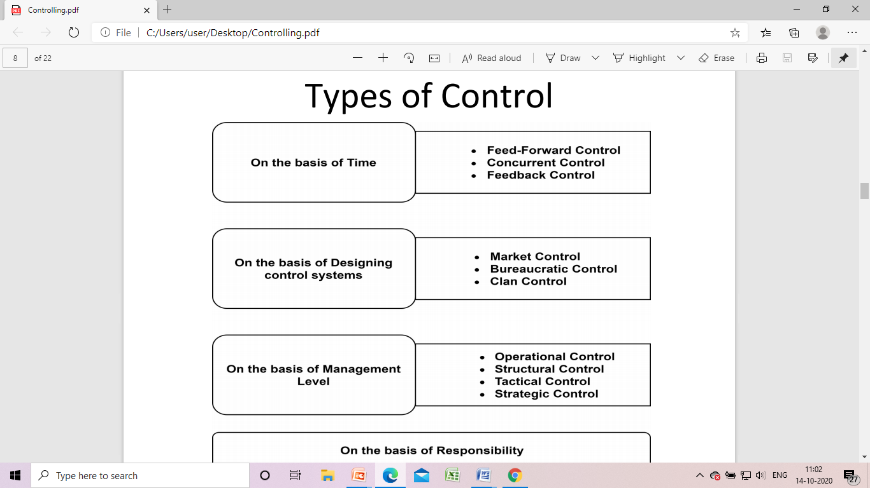

Slide 13
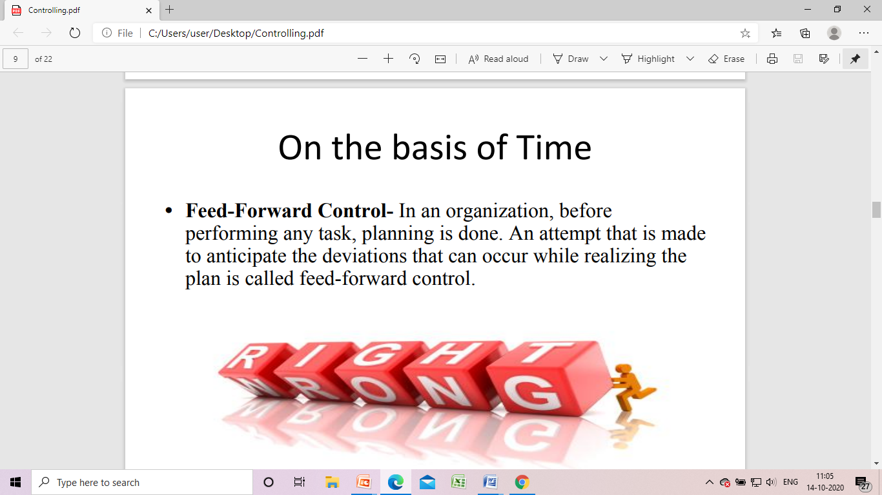

Slide 14
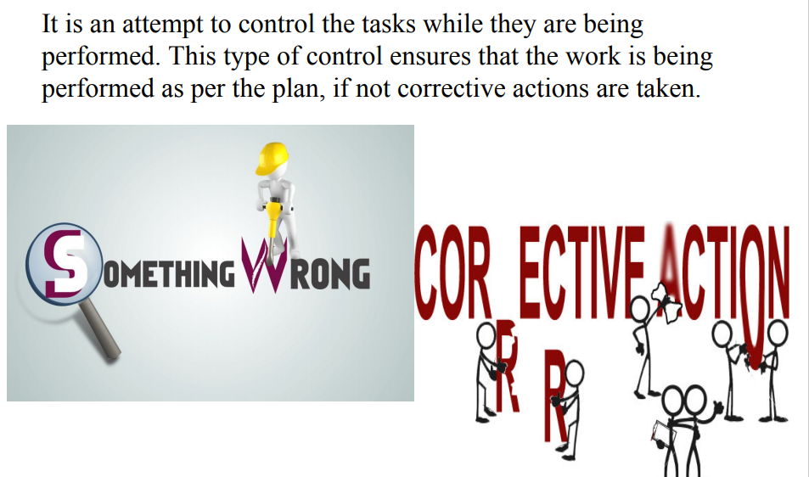
Concurrent control

Slide 15
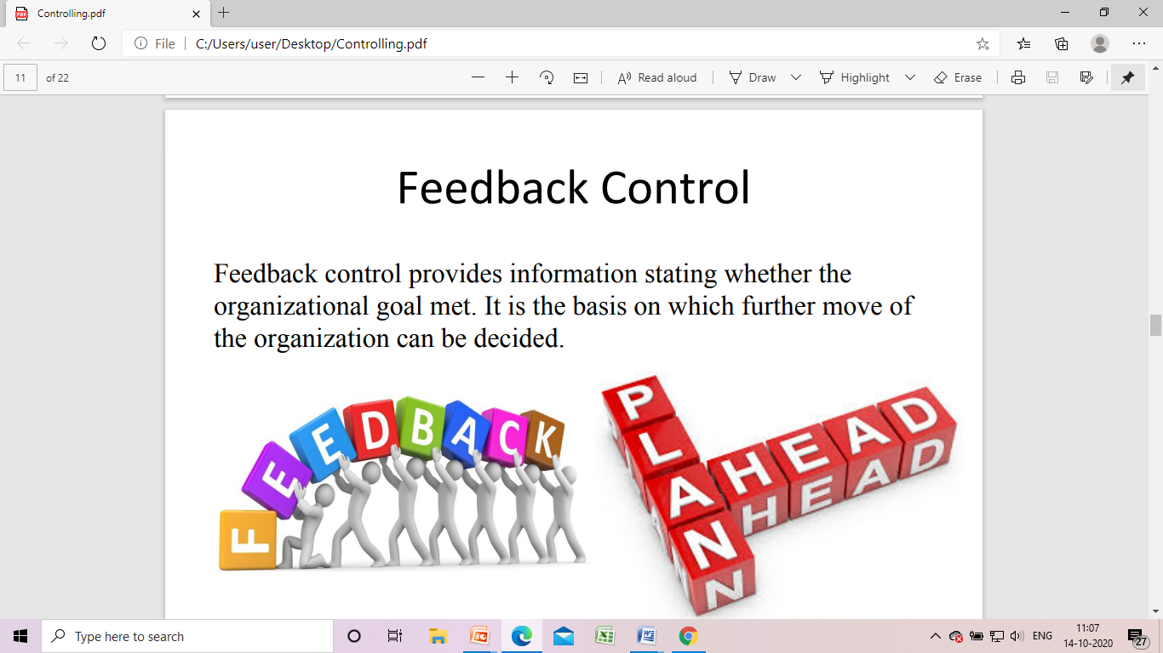

Slide 16
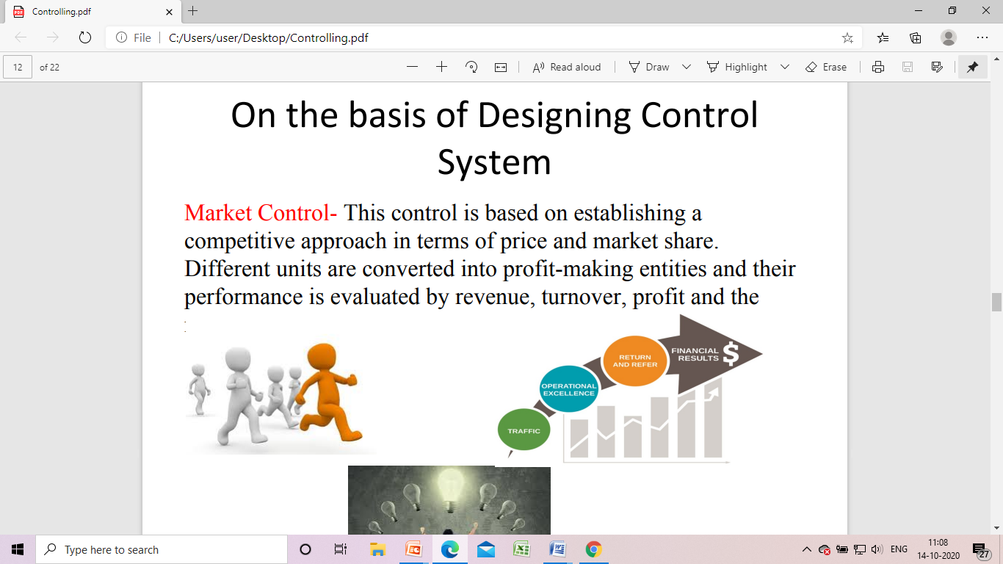

Slide 17
Bureaucratic Control
Bureaucratic control focuses on power, policies and procedure and it has been adopted by most of the Indian public sector undertaking.
For example, a hospital cannot issue medicine unless prescribed by a Doctor

Slide 18
Clan Control
Control of the employees or members of an organization through shared values, belief structures, and cultural norms, rather than through traditional bureaucratic control procedures.

Slide 19
On the basis of management level
Operational Control- The day-to-day control process at the lowermost level of the organization which also includes financial and quality control as the part of operational control activities.
Structural Control- The structural control refers to the organization structure and hierarchy where every individual is accorded a role and responsibility, and progress in task assigned is monitored for each individual thereby exercising control.

Slide 20
…..
Tactical Control- Tactical control implies meeting the departmental objective and controls are exercised by middle management of the organization.
Strategic Control- Strategic controls imply the effectiveness of a corporate, business and functional strategies helpful for organization to meet its goal.

Slide 21
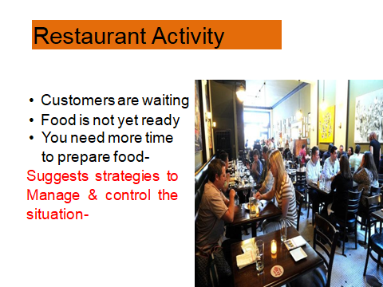

Slide 22
Traditional Techniques of Controlling
BUDGET
Budget is a financial plan that is used to estimate the revenue and expenses over a specified future period of time.
The budgeting process is carried out to identify whether the organization can continue to operate with its projected income and expenses.

Slide 23
………….
Personal Observation
The simplest way to control organizational activities is that managers take round at the work place and observe the progress of the work. Any defect in performance can be spotted and corrected immediately.

Slide 24
………..
Break-Even Analysis
Break-even analysis or cost-volume-profit analysis defines the relationship between sales volume, costs and profits to arrive at a figure of sales at which sales revenue is equal to cost. The point at which sales revenue is equal to cost is the break-even point.
Sales beyond the break-even point will earn profits for the organization and sales below the break-even point is a situation of loss.

Slide 25
………….
Financial Statements
Financial statements depict financial position of the firm over a period of time, generally one year.
The statements are prepared along with last year’s statements so that firm can compare present performance with last year’s performance and take action to improve its future performance.
As these statements are prepared at the end of the financial year, as a measure of control, they guide managers to improve future performance

Slide 26
……….
Statistical Data and Reports
Statistical data and regular reporting system provide information about company’s financial and non-financial performance.
A supervisor, for example, prepares a special report on how the salesmen are dealing with customers. This report helps managers to control the behavioral attitudes of salesmen to develop a good clientele.

Slide 27
Modern Techniques
Zero-based budgeting
It is a method of budgeting in which all expenses must be justified for each new period. The process of zero-based budgeting starts from a "zero base," and every function within an organization is analyzed for its needs and costs.

Slide 28
………….
Management Information System (MIS)
To carry out managerial functions of planning through controlling for various functional areas and integrate them with the external environment managers need different types of information.
Computers enable managers to collect data at very short intervals of time, process, analyze, convert it into useful information and relate it to the external environment.

Slide 29
………
Management Audit
Audit means periodic inspection of financial statements and verifying that the statements are honestly and fairly prepared according to accounting principles.

Slide 30
…………
Responsibility Accounting/Centers
It divides the organization into smaller units where each unit is headed by a manager who is responsible for achieving the targets of his unit.
These units are called responsibility centers and the head of each responsibility centre is responsible for controlling the activities of his centre.
Performance of each responsibility centre is judged by the extent to which targets of that centre are achieved.

Slide 31
…………
Network Techniques (PERT and CPM):
When a complex project is undertaken which involves a series of inter-related activities, the network models or techniques help in planning, coordinating and controlling the network of activities.
PERT-Program Evaluation and Review Technique
CPM-Critical Path Method

Slide 32
……..
Balanced Score Card:
Balanced score card is “a performance measurement tool that looks at four areas — financial, customer, internal processes and people assets — that contribute to a company’s performance.”
It evaluates organizational performance in terms of financial and non-financial parameters.

Slide 33
………..
Ratio Analysis
Input-output ratio.
Ratios can be used to compare current performance of the company with its past performance.
Performance over a period of time in a year can also be compared. This helps managers in making predictions.
A fall in the profit ratio, for example, requires managers to take corrective action.

Slide 34
Staffing
HRM: Human Resource Management is the strategic approach to the effective management of people in a company or organization such that they help their business gain a competitive advantage.

Slide 35
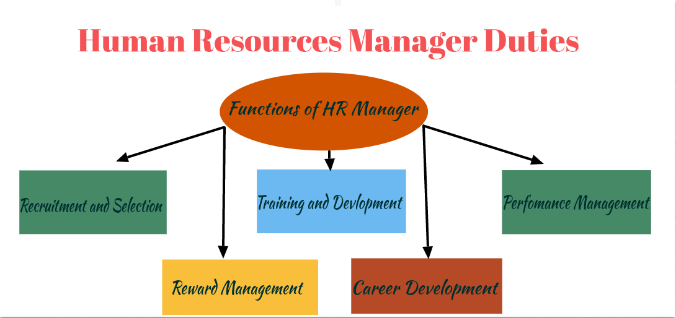
Functions of HRM

Slide 36
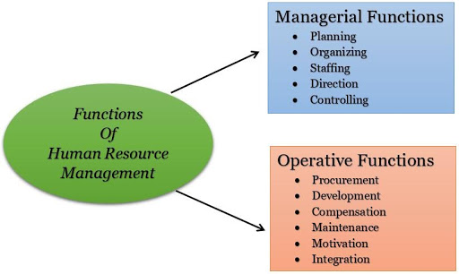

Slide 37
SELECTION
Selection is the process of choosing a qualified person for specific job role who can successfully deliver valuable contributions to the organization.
It is a negative function of HRM as it involves rejection.

Slide 38
